Slide 1


The Currency Forecast: “Cloudy with a chance of Rain” - for the Individual Investor
Levi Christian; James Pak; Troy Wilson

Slide 2
Motivation & Summary Slide
Core Message
Event Driven Robo Advisor in Currency Markets with Crystal Ball for upcoming Announcements
Questions & Why
Can we recommend with high enough confidence based on Consensus predictions?
Solutions & Findings
What was our performance’s confidence interval [ ] from the recommendations?

Slide 3
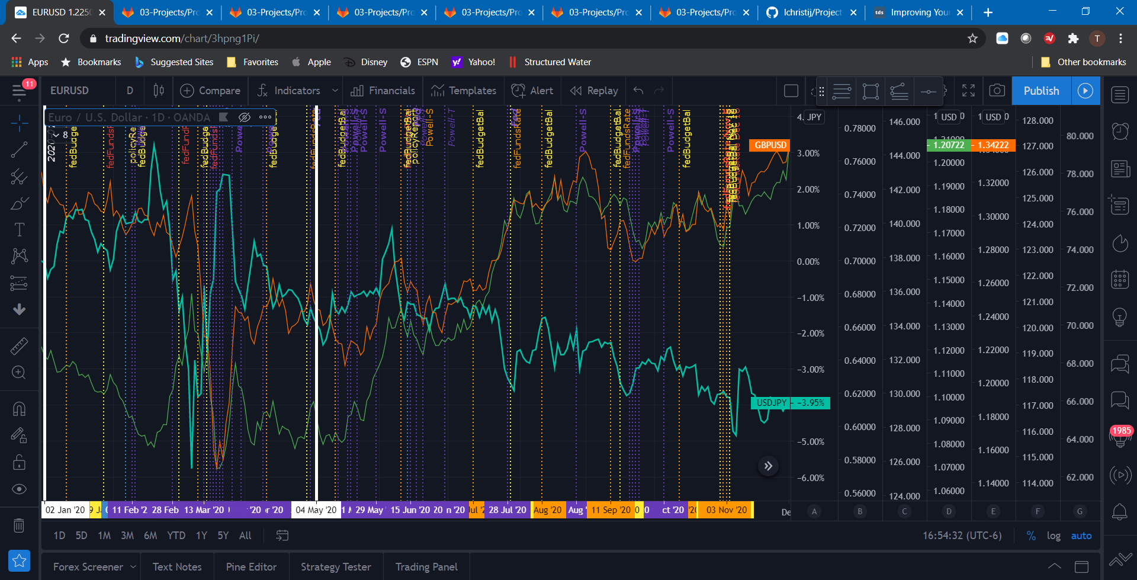
Historical Precedence

Slide 4
Hypothesis / Core Questions
Based on the economic calendar forecasts that highly impact the currency pair (EUR/USD, GBP/USD, USD/JPY), can we provide Buy/Sell/Neutral recommendations within 4 weeks of upcoming news events?
Given an initial investment amount of $10,000 and assuming recurring 8 week holding periods over 5 years, with what confidence can we produce an expected return for the investor over that holding period?
Can we iteratively improve the confidence interval of our recommendations through additional Time Series Analysis, NLP, and Machine Learning?

Slide 5
Data / Data Cleanup & Exploration
FX_Daily Pricing Data: Alpha Advantage through RapidAPI: 2001 – 2021
EUR/USD [FXE], GBP/USD [FXB], USD/JPY [FXY]
Economic Calendar Data: web scraped from BabyPips: 2017 – 2021
Forecasted vs. Previous Consensus Numbers
Beautifulsoup4 utilization
Key Field Indicator was required
Daily Open High Low Close (OHLC) for each currency pair [EUR/USD; GBP/USD; USD/JPY] & ETF [FXE, FXB, FXY]
Scraped Data: Currency, Date/Time Stamp, High Impact Announcement, Forecast, Previous, Actual

Slide 6
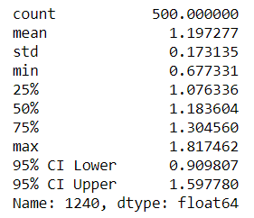
Data Analysis
Buy/Sell/Neutral Recommendations on Previous vs. Forecast Analysis
Monte Carlo performance prediction on Long directional bias on ETFs for basis of comparison/benchmark for each currency pair

Slide 7
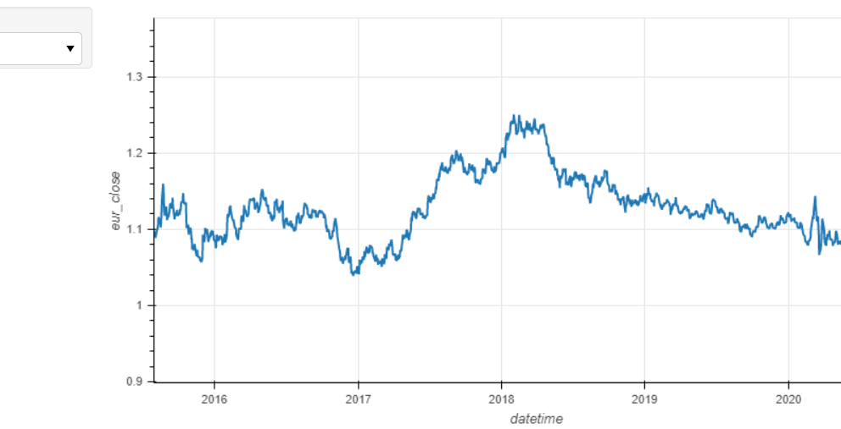

Slide 8
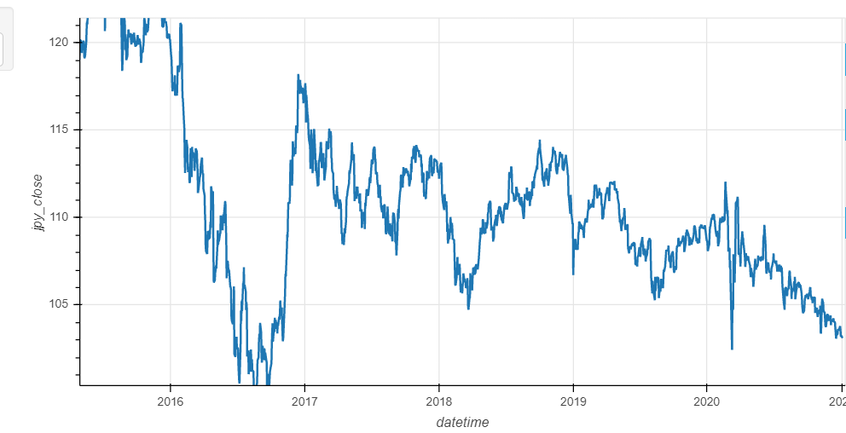

Slide 9
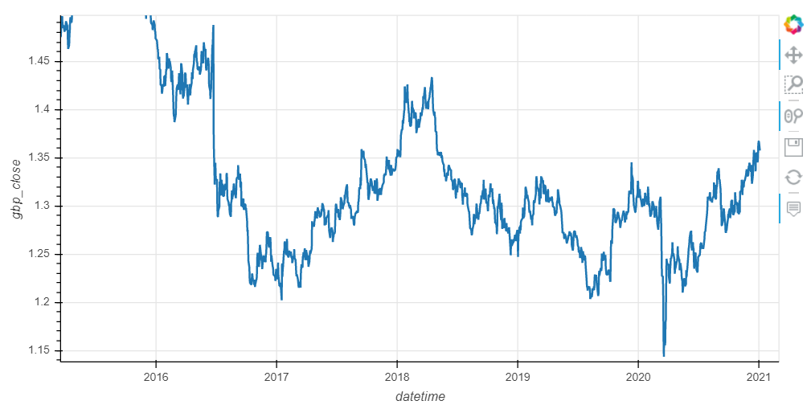

Slide 10
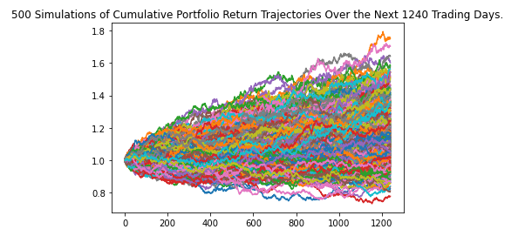

Slide 11
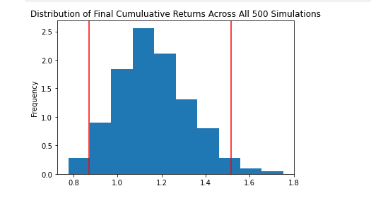

Slide 12
Discussion
We found that the currency volatility caused by the event / news announcements generates opportunities for the Individual Investor to profit in both the short and long terms.
We did expect to find this result, but it was much more difficult than anticipated to include both Long/Short recommendations to properly analyze via Monte Carlo.
We also had to manually input a “Key Value Indicator” to assist with the calculations. We believe this KVI can be automatically produced via NLP, and ML can assist with the “weighted impact” of each news event.

Slide 13
Postmortem
It was difficult to scrape/clean the data effectively enough to be able to utilize for the analysis. Once completed, we did see a greater opportunity to expand our recommendations in both directions (Long/Short).
We believe with additional time for research, we can add this additional dimension to provide even greater returns over the same holding periods.
Our next iteration beyond that would involve exploring Time Series Analysis to provide additional indicators, Natural Language Processing to automate the KVI, and Machine Learning to produce our own “Forecast Consensus” to streamline the entire recommendation process for full automation on a weekly basis.

Slide 14

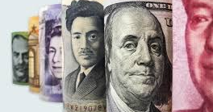
Questions?

